Slide 1
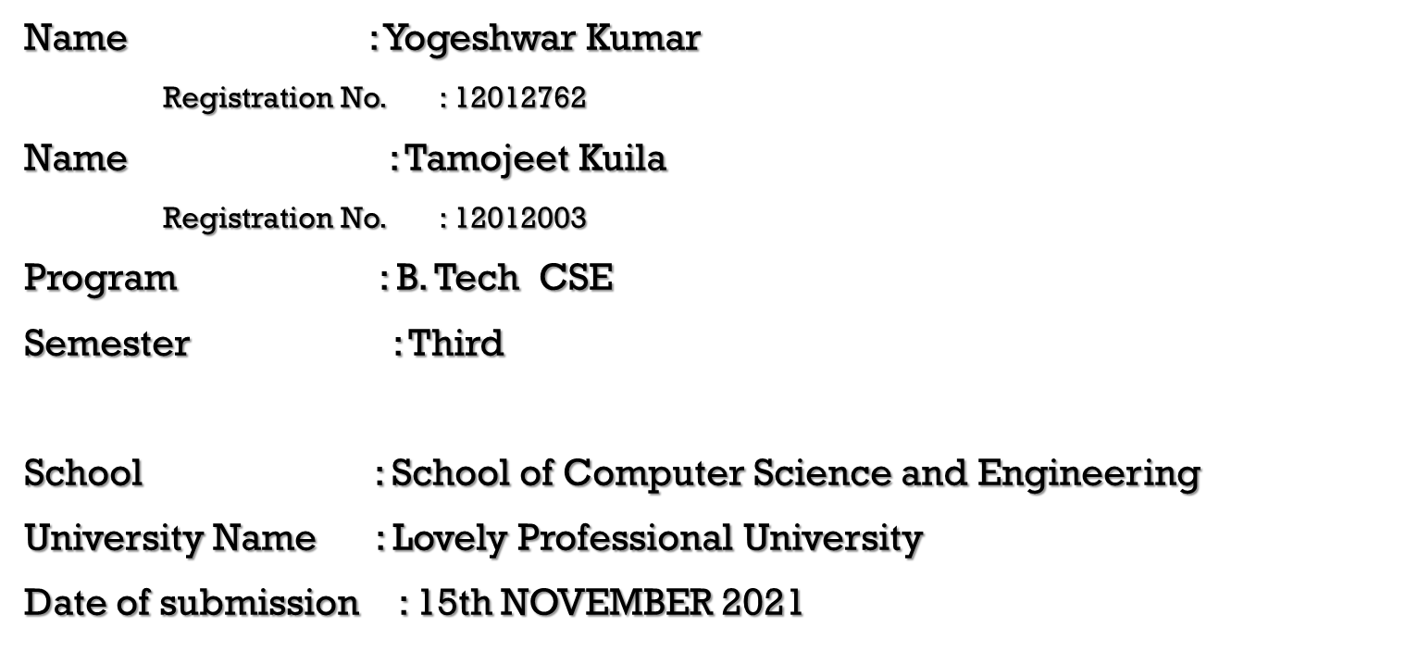


Slide 2
Acknowledgment
We are deeply indebted to our teacher Dr. Sukhvir Kaur Ma’am.
We further thank to all the staff members of LOVELY PROFESSIONAL UNIVERSITY PHAGWARA. We also express our deepest gratitude to our parents

Slide 3
Introduction to the Project
A Scientific Calculator is a calculator designed to help you calculate science, engineering, and mathematics problems. It has way more buttons than your standard calculator that just lets you do your four basic arithmetic operations of addition, subtraction, multiplication, and division. This Scientific calculator is made with python which can be easily used by anyone.
Roles
Yogeshwar Kumar: “I wrote the core part of the Calculator”.
Tamojeet Kuila: “I wrote the design part of the Calculator”.
Together finally we went through the code thoroughly and struggled through the Errors. And finally made it through the final Calculator.

Slide 4
Libraries Used
Tkinter is the standard GUI library for Python. Python when combined with Tkinter provides a fast and easy way to create GUI applications. Tkinter provides a powerful object-oriented interface to the Tk GUI toolkit.
Creating a GUI application using Tkinter is an easy task. All you need to do is perform the following steps −
Import the Tkinter module.
Create the GUI application main window.
Add one or more of the above-mentioned widgets to the GUI application.
Enter the main event loop to take action against each event triggered by the user. Tkinter also offers access to the geometric configuration of the widgets which can organize the widgets in the parent windows. There are mainly three geometry manager classes class.
pack() method: It organizes the widgets in blocks before placing in the parent widget.
grid() method: It organizes the widgets in grid (table-like structure) before placing in the parent widget.
place() method: It organizes the widgets by placing them on specific positions directed by the programmer.

Slide 5
Uses of Scientific Calculator
Basic functions and exponents. Calculate basic functions such as addition, subtraction, multiplication, and division. ...
Logarithms. ...
Sine, cosine, and tangent functions. ...
Scientific notation. ...
Binary functions.
Scientific numbers that have a multiplication by 10 to a certain power
π problems
Logarithm problems with base 10 and the natural base
Probability problems that use the factorial function

Slide 6
Benefits of Scientific Calculator
This technology allows students solve complicated problems quickly and in an efficient manner. Additionally, it can reduce the problem to simpler tasks and allows the student to devote more time in understanding the problem. Secondly, they are saved from monotonous calculations and the same boring mundane procedure.

Slide 7
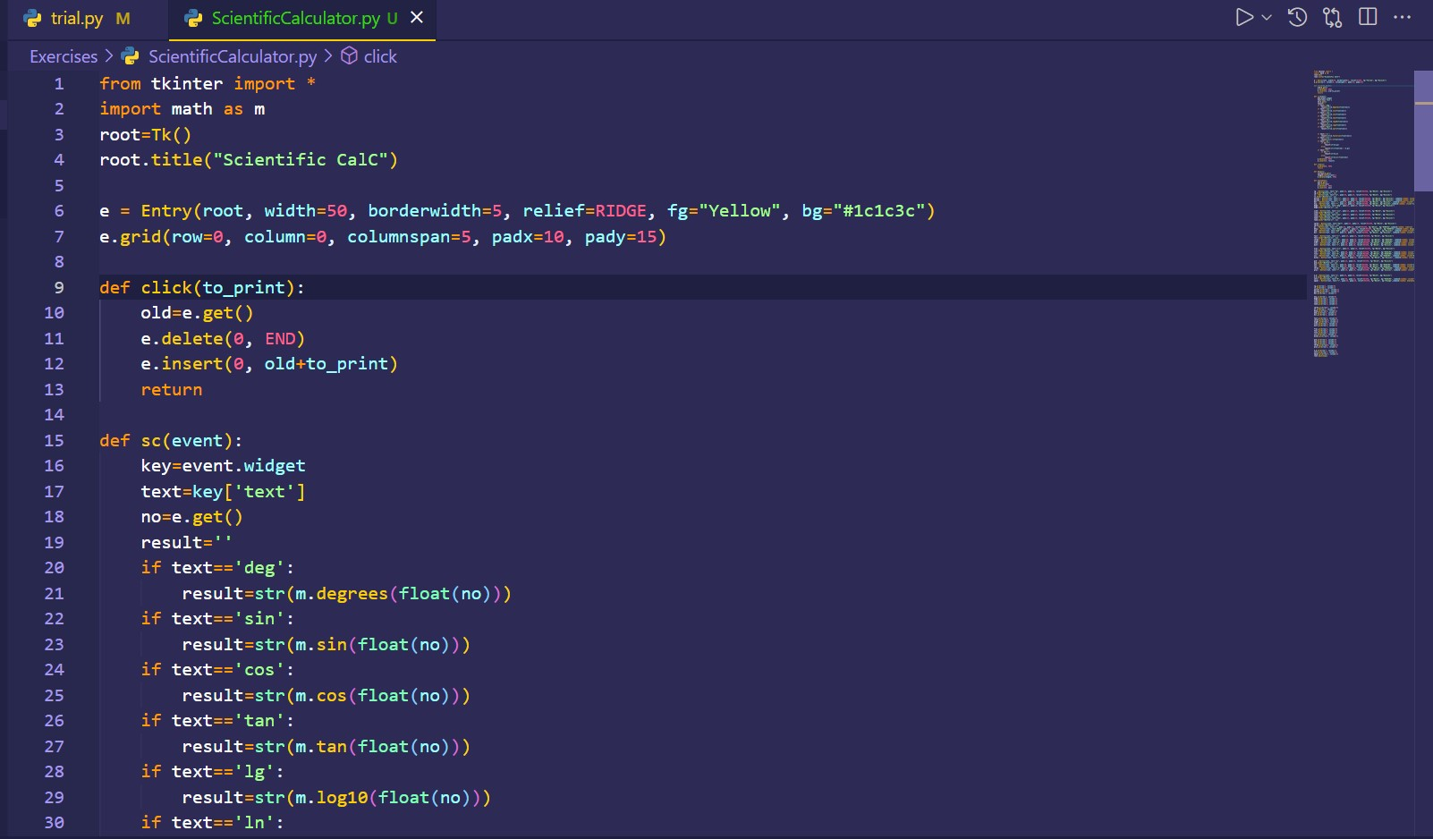
Code:-

Slide 8
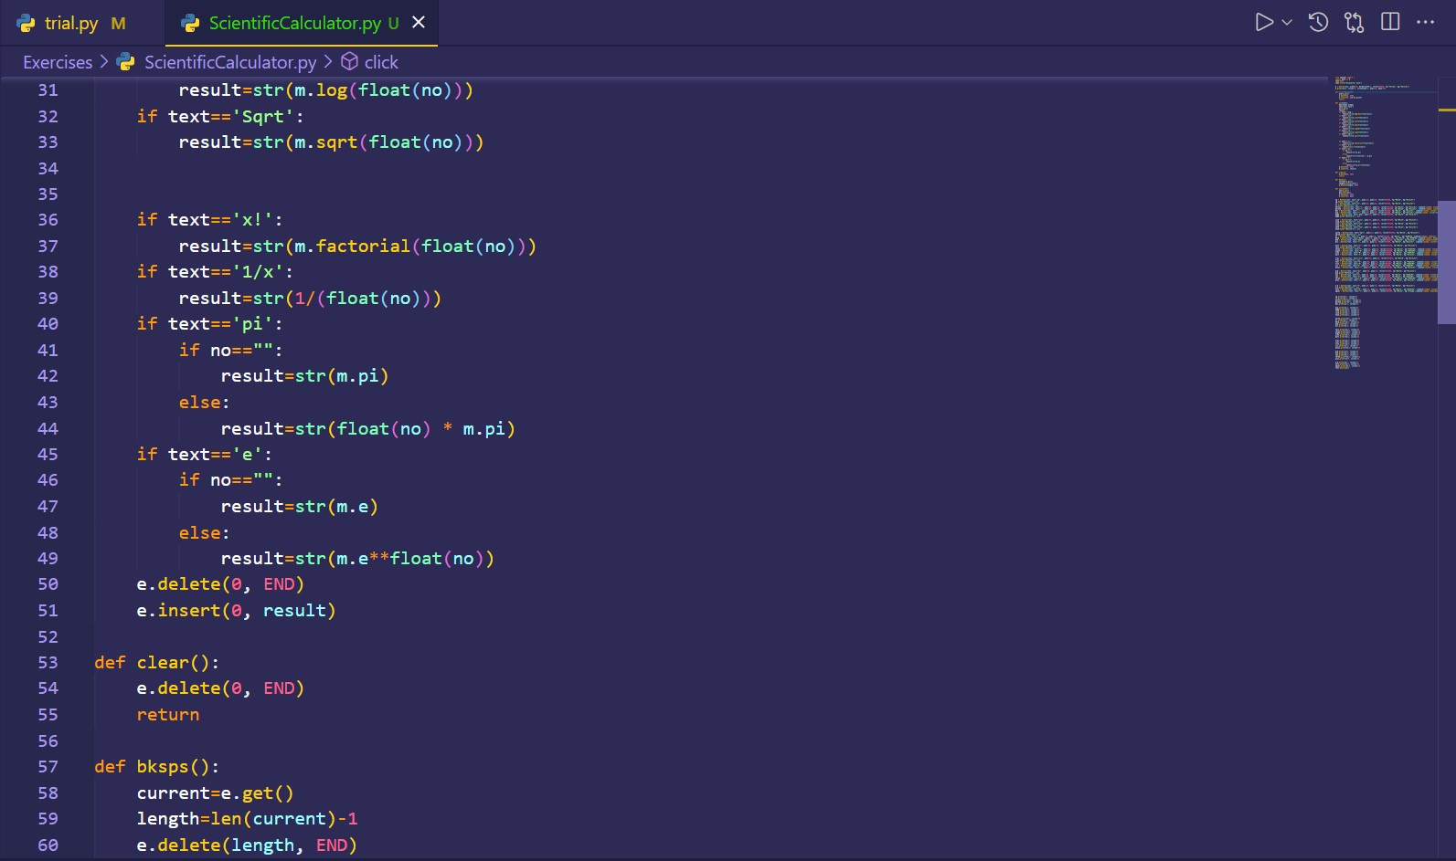

Slide 9
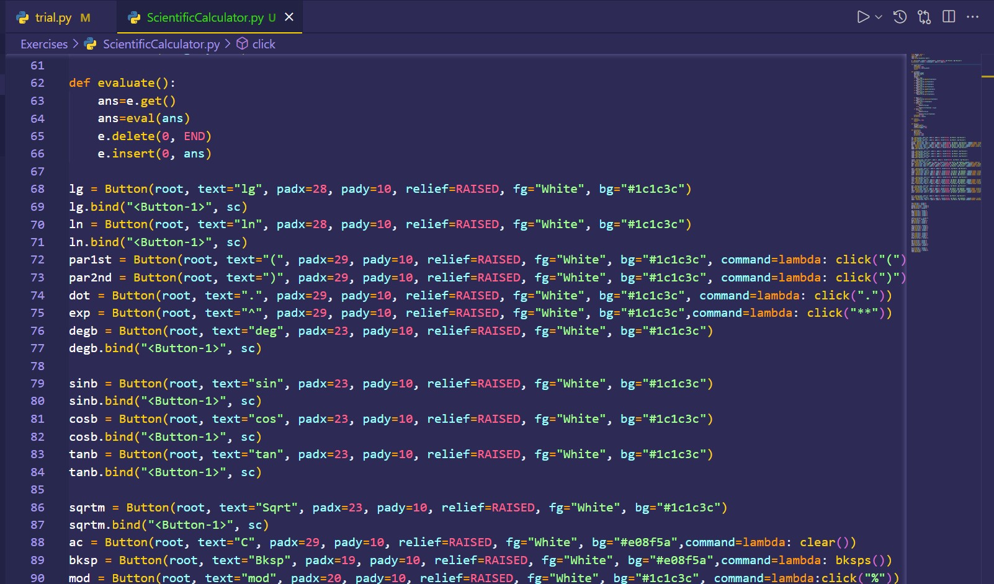

Slide 10
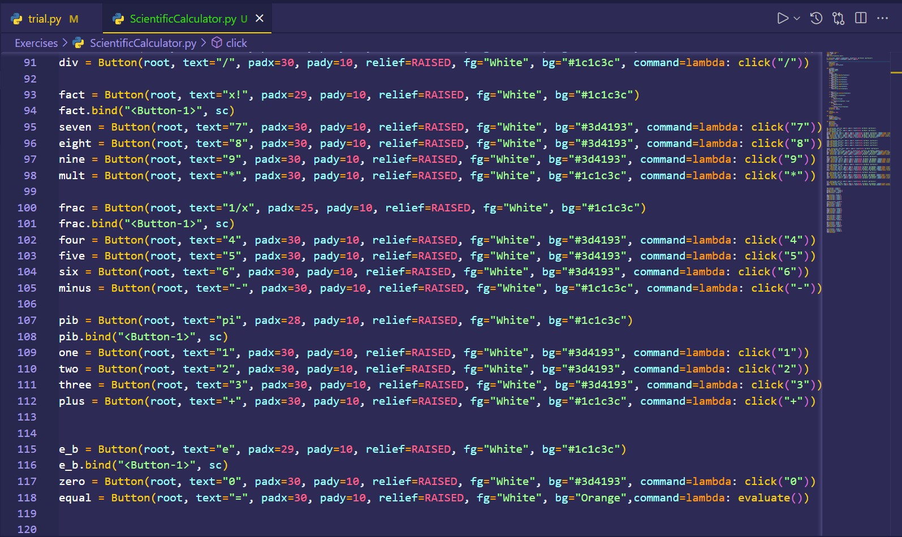

Slide 11
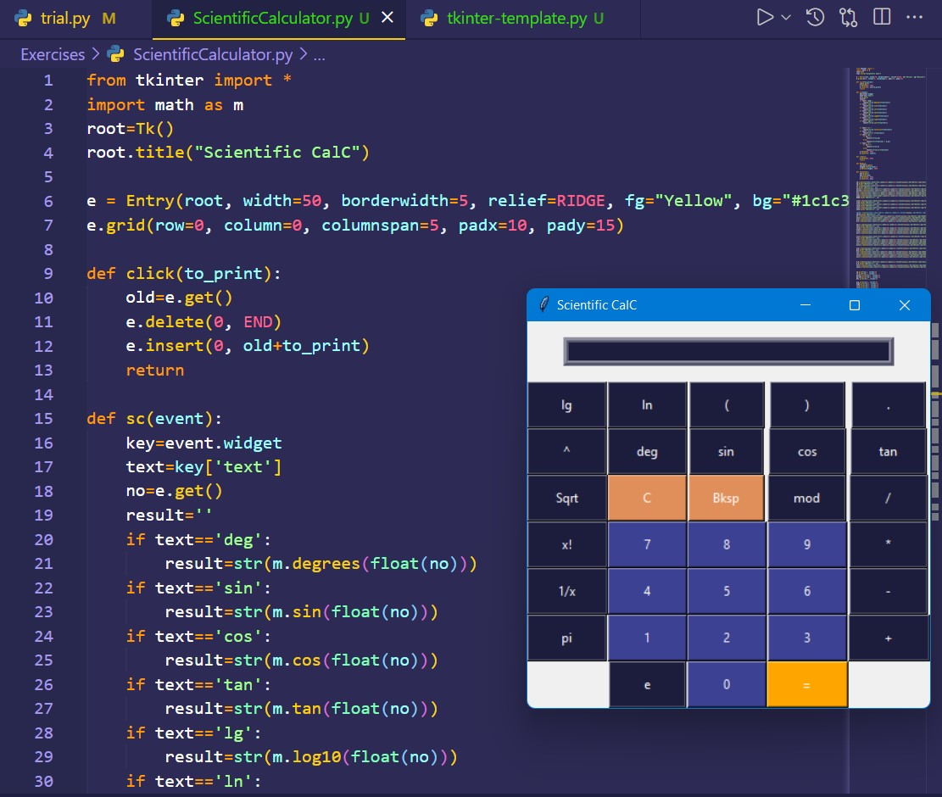
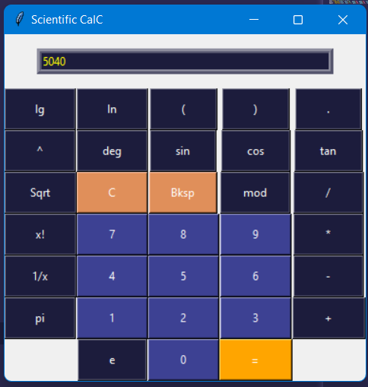
Output

Slide 12
References
https://www.javatpoint.com/python-tkinter
https://www.geeksforgeeks.org/python-tkinter-tutorial/

